Slide 1

Lifelong Domain Adaptation via Consolidated Internal Distribution
=

Slide 2

Introduction to the problem :- Problem: Addressing Unsupervised Domain Adaptation (UDA) in Continual Learning (CL) settings. Goal: Update models to learn distributional shifts across tasks with unlabeled data while retaining past knowledge without giving access to previous data to avoid time consumption, which is a major factor while training data.

Slide 3

Major Challenges
Catastrophic Forgetting: The tendency of a model to forget previously learned information upon learning new tasks.
Domain Shift: The difference in data distribution between the source and target domains.

Slide 4

Robust generalization on unseen data is difficult when there is a domain shift between training and testing data. We have the following approaches for this problem.
Continual Learning (CL): In CL, the goal is to adaptively learn over time as the input distribution changes, which often leads to performance degradation and requires model retraining.
Unsupervised Domain Adaptation (UDA): UDA aims to train a model for a target domain with unannotated data by transferring knowledge from a related source domain with annotated data.

Slide 5
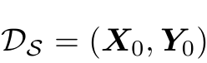
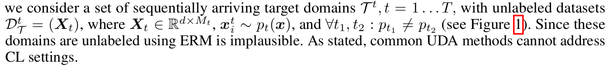

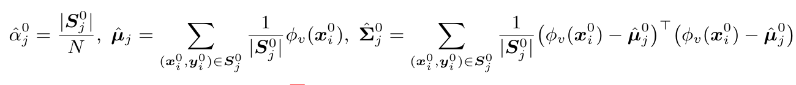
Given Dataset
Train a Neural network Model.

Slide 6
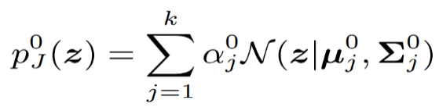

Proposed Solution
Consolidate internal distributions using GMM: Internal representations are modeled as a Gaussian Mixture Model, capturing the structure of learned data.
Gaussian Mixture Model (GMM)
GMM Definition: A GMM is a probabilistic model that assumes all data points are generated from a mixture of several Gaussian distributions with unknown parameters.
Mathematical Formulation:
where α are the mixture weights, µ are the means, and
Σj are the covariances of the Gaussian components.
Optimization Problem:
Minimize the discrepancy between the source and target domain distributions.

Slide 7
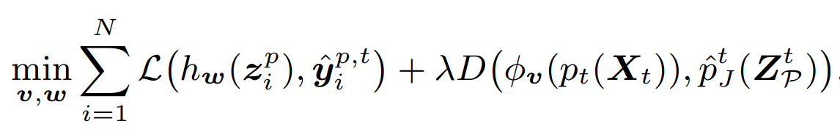

Loss function :-
Preserve
Generalisability on
Internal Distribution
Prediction from Neural Network
Enforces alignment of Target domain distribution with the internally learned
More Generalised Loss form :-
The last two functions avoid catastrophic forgetting by calculating
the distance from means from action replay.
Consolidate the internal distribution across all the previous tasks
Memory Buffer to
Avoid Catastrophic
Forgetting

Slide 8
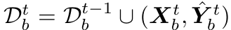

Experience Replay through Memory Buffer
Given a memory budget of Nb samples, we pick the Mb=Nb/k samples per class that have the closest distance to the mean to form the buffer-store dataset.
This will store the most important points from the old dataset
to avoid catastrophic forgetting. Not explicitly having the entire
Dataset but the points which are closest to the mean.

Slide 9

Theoretical Analysis of LDAuCID Algorithm
Objective:To mitigate Catastrophic Forgetting and improve model generalization in lifelong Unsupervised Domain Adaptation (UDA).
Key Concepts:
Internal Distribution Consolidation: Maintain stability of the learned internal distribution across tasks.
Experience Replay: Store and replay representative samples to retain past knowledge.
Theorem: Demonstrates that minimizing the empirical error and aligning task distributions in the embedding space reduces forgetting and enhances generalization.
It is validated using standard UDA benchmarks, showing improved performance and reduced forgetting.

Slide 10

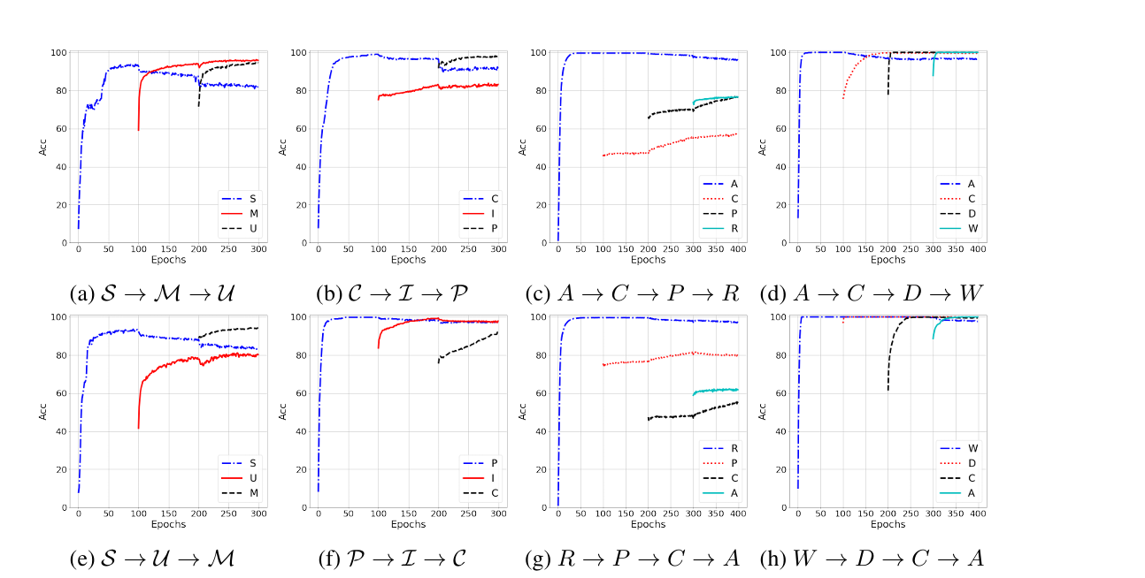
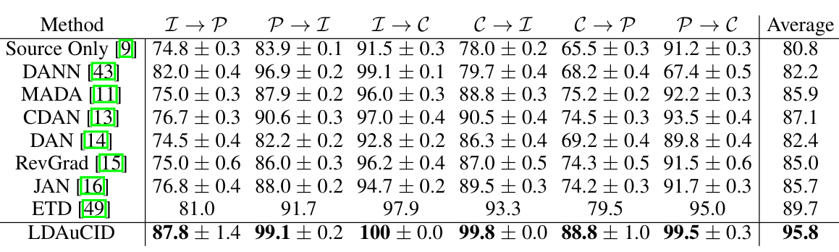

Results Presented in the Papers
Four existing UDA benchmarks have been used to validate the model (MNIST, ImageCLEF-DA, Office-Home, Office-Caltech)
Learning curves for the above eight sequential UDA tasks are visualized in Figure.
This initial jumpstart occurs due to similarities between the domains, leading to knowledge transfer from past experiences.
The second important observation is that catastrophic forgetting has been mitigated quite well.
From the Previous UDA algorithms, our Proposed LDAUCID has the highest average accuracy which validates the model.
Through the graphs we can clearly see even If we have changed the domain there is no significant loss in the accuracy of the model.

Slide 11

Conclusions
Algorithm Development: The paper introduces an algorithm for domain adaptation in continual learning, focusing on consolidating internal distributions to improve generalization.
Mitigating Forgetting: It addresses catastrophic forgetting by using experience replay, which involves storing and replaying key samples to retain past knowledge.
Empirical Validation: The method was tested on standard UDA benchmarks, showing improved performance and reduced forgetting.
Future Research: Future work includes exploring task order effects and extending the method to incremental learning settings.
Potential Improvements: Suggestions include better internal distribution estimations and incorporating class-conditional alignment techniques for datasets with larger domain gaps

Slide 12

Group Members
Sankul (220965)
Gautam Kumar (220407)
Ayush Patel (220269)
Bhavishya Gupta (220295)
Harshit Gupta (220439)

Slide 13

References Research paper titled “Lifelong Domain Adaptation via Consolidated Internal Distribution” by Mohammad Rostami, USC Information Sciences Institute Los Angeles, CA 90007

